Slide 1
Predicting NHL Wins
Jessica Nell

Slide 2
Motivation
No advanced analytics used in the NHL

Slide 3
Data
(snapshot of data)
Home Team, Away Team, Game Date
Followed by a number of predictors for both teams based on the past 10 games

Slide 4
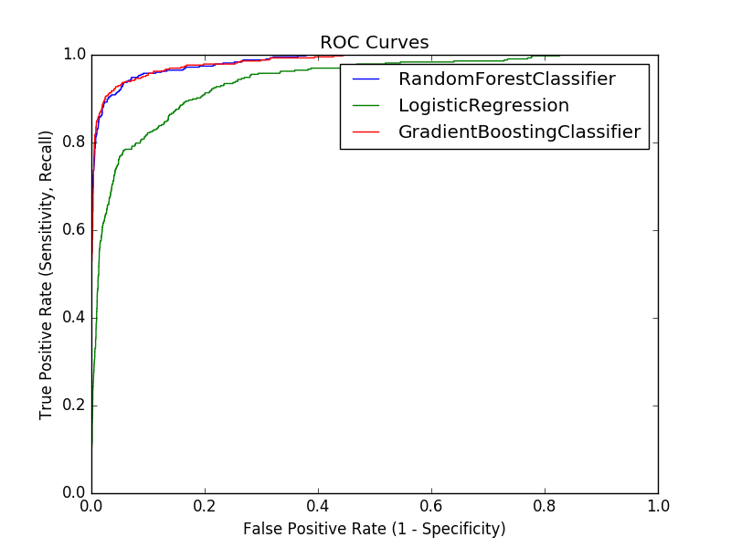
Models

Slide 5
Best Model
Random Forest Classifier
Using data for past 10 games
66% accuracy

Slide 6
Predictions
Home Team | Away Team | Date | Prediction | Actual
NJD | BUF | 11/11/2016 | 1 | 1
PHI | TOR | 11/11/2016 | 0 | 1
LAK | OTT | 11/11/2016 | 1 | 1
WSH | CHI | 11/11/2016 | 0 | 0
WPG | COL | 11/11/2016 | 0 | 1
DAL | EDM | 11/11/2016 | 1 | 1
MIN | NSH | 11/11/2016 | 1 | 1
CAR | BOS | 11/11/2016 | 0 | 1
ARI | NYR | 11/11/2016 | 0 | 0

Slide 7
Predictions
Home Team | Away Team | Date | Prediction | Actual
NJD | BUF | 11/11/2016 | 1 | 1
PHI | TOR | 11/11/2016 | 0 | 1
LAK | OTT | 11/11/2016 | 1 | 1
WSH | CHI | 11/11/2016 | 0 | 0
WPG | COL | 11/11/2016 | 0 | 1
DAL | EDM | 11/11/2016 | 1 | 1
MIN | NSH | 11/11/2016 | 1 | 1
CAR | BOS | 11/11/2016 | 0 | 1
ARI | NYR | 11/11/2016 | 0 | 0

Slide 8
Predictions
Home Team | Away Team | Date | Prediction | Actual
NJD | BUF | 11/11/2016 | 1 | ?
PHI | TOR | 11/11/2016 | 0 | ?
LAK | OTT | 11/11/2016 | 1 | ?
WSH | CHI | 11/11/2016 | 0 | ?
WPG | COL | 11/11/2016 | 0 | ?
DAL | EDM | 11/11/2016 | 1 | ?
MIN | NSH | 11/11/2016 | 1 | ?
CAR | BOS | 11/11/2016 | 0 | ?
ARI | NYR | 11/11/2016 | 0 | ?

